Slide 1

BuildIt
By: James Baron

Slide 2
Introduction
Background- How I can up with this project and all about the final product.
Progress- all progress that I have made overall and specifically what has been made since the last intermediate presentation.
Conclusion- what will be completed by the next milestone.

Slide 3
Background
Creating an IOS application designed for construction companies.
Idea stemmed from working at my father’s construction company.
Unorganized and inefficient work being conducted.
BuildIt is the solution to these problems.

Slide 4
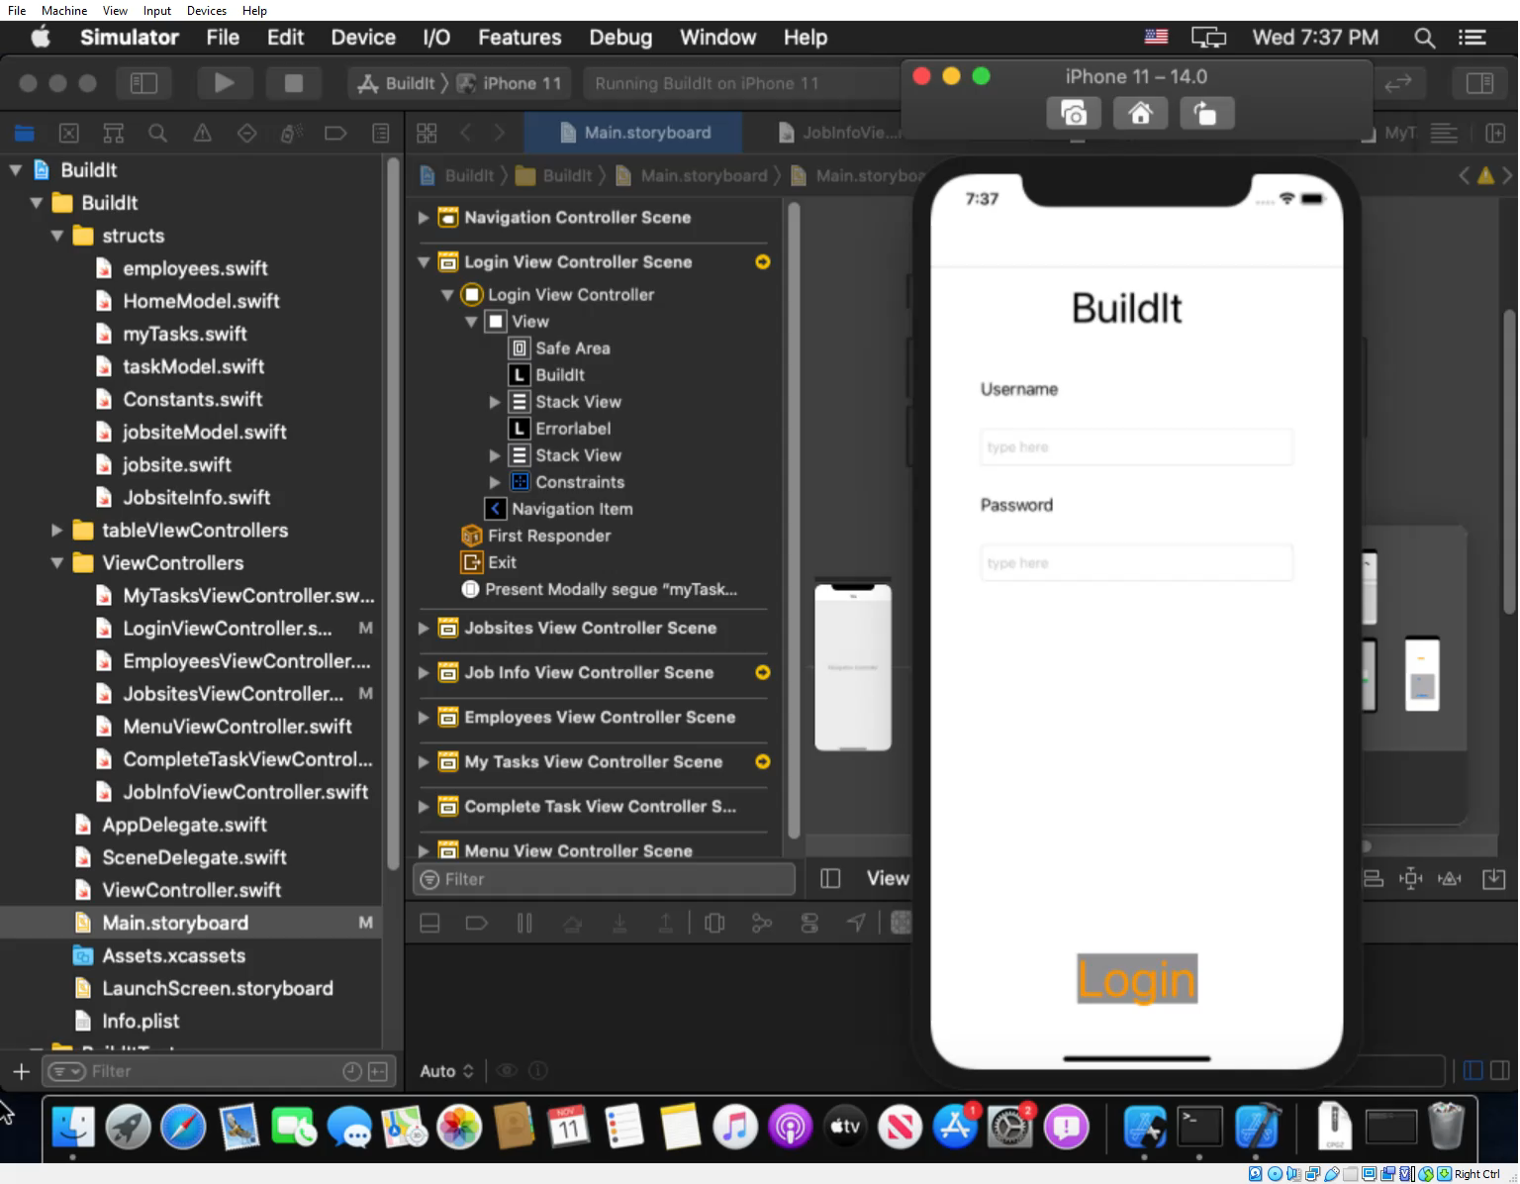

Slide 5
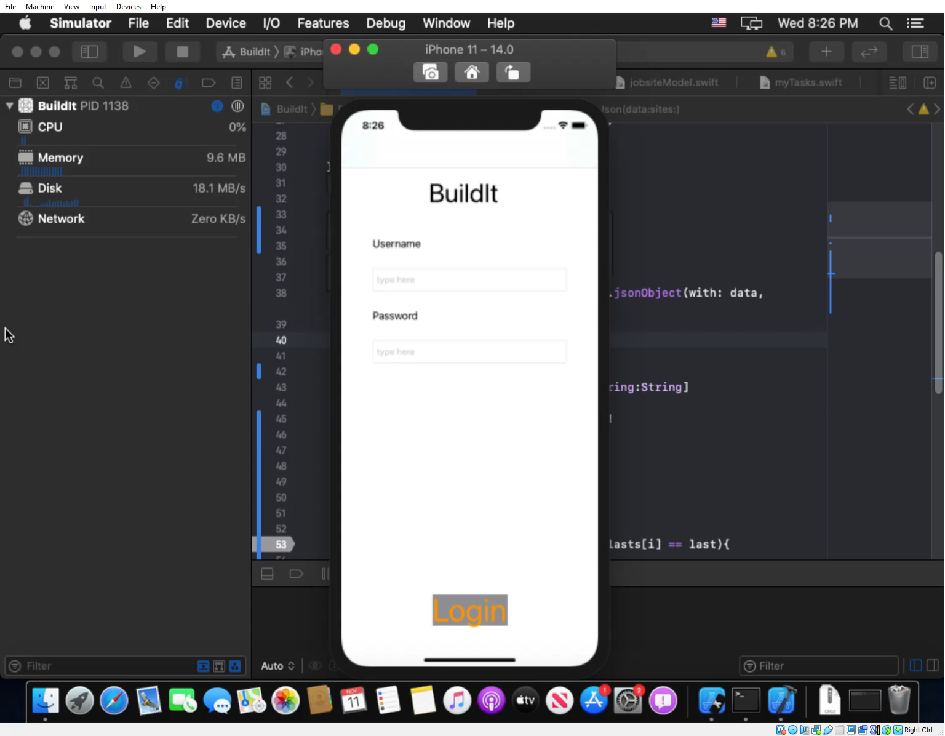

Slide 6
Progress made
Last presentation showed my database and login screen User interface completed.
Employees User interface is complete.
Jobsites User interface is complete.
myTasks User interface is very close to complete.

Slide 7
Employees
First time connecting database through a webservice to the IOS app.
Uses a table view.

Slide 8
Jobsites
Complex because it uses two table views and two view controllers.
Goal is so that users can see where fellow employees are working.

Slide 9
My tasks
Was difficult to figure out how to only display tasks for logged user.
Segue made it possible.
Task complete function is not yet finished.

Slide 10
Conclusion
What needs to be done: create task, add employee, delete task function and visual improvements.
Next weekly update- be ready for testing
Final presentation- should be able to finish and have a solid demo
Link to github: https://github.com/jbarontennis/BuildIt.git

